Slide 1
CIS355A Business Application Programming Course Project
Software Engineer: Edward Alvarado
Professor: Mehdi Arjomandi

Slide 2
Timeline
Designing
Developing a Wireframe diagram and UML Class Diagram for what will eventually become the project.
Developing GUI
We take the time to flesh out the overall design of our graphical user interface using our wireframe diagram and UML class diagram as a blueprint for our work.
Advanced Controls
Focusing on some of the advanced controls of our GUI we begin to add the functionality, bringing our design to life.
Arrays – Tabs - JLists
Digging into the design with Tabs and Jlists creates a cleaner look and adds functionality to the GUI.
IO Functionality
Adding the ability to save data to your system creating a persistent state that allows the user to create, save and load information as needed.
Database Functionality
Allows the user to take the previous IO functionality and use databases like SQL to host the information. Database functionality is fully fleshed out and uses three-tier architecture.

Slide 3
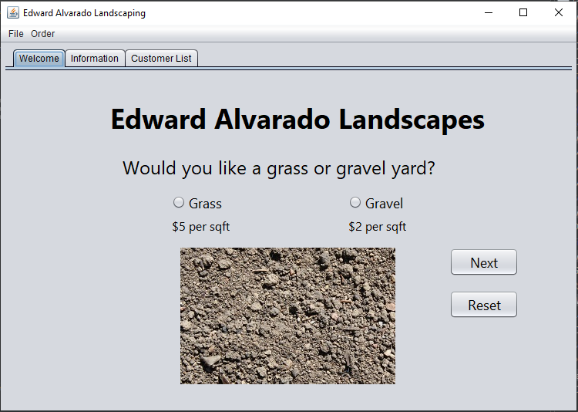
Introduction
The following presentation outlines a software development lifecycle as we take a program from conception to execution. We will review UML diagrams, wireframe diagrams, developing a GUI, advanced GUI controls, ArrayLists, Tabs, JLists, IO functionality and Database functionality. We’ll delve deeper into each section, discuss challenges faced, career skills obtained, received peer reviews and discuss final conclusions.

Slide 4
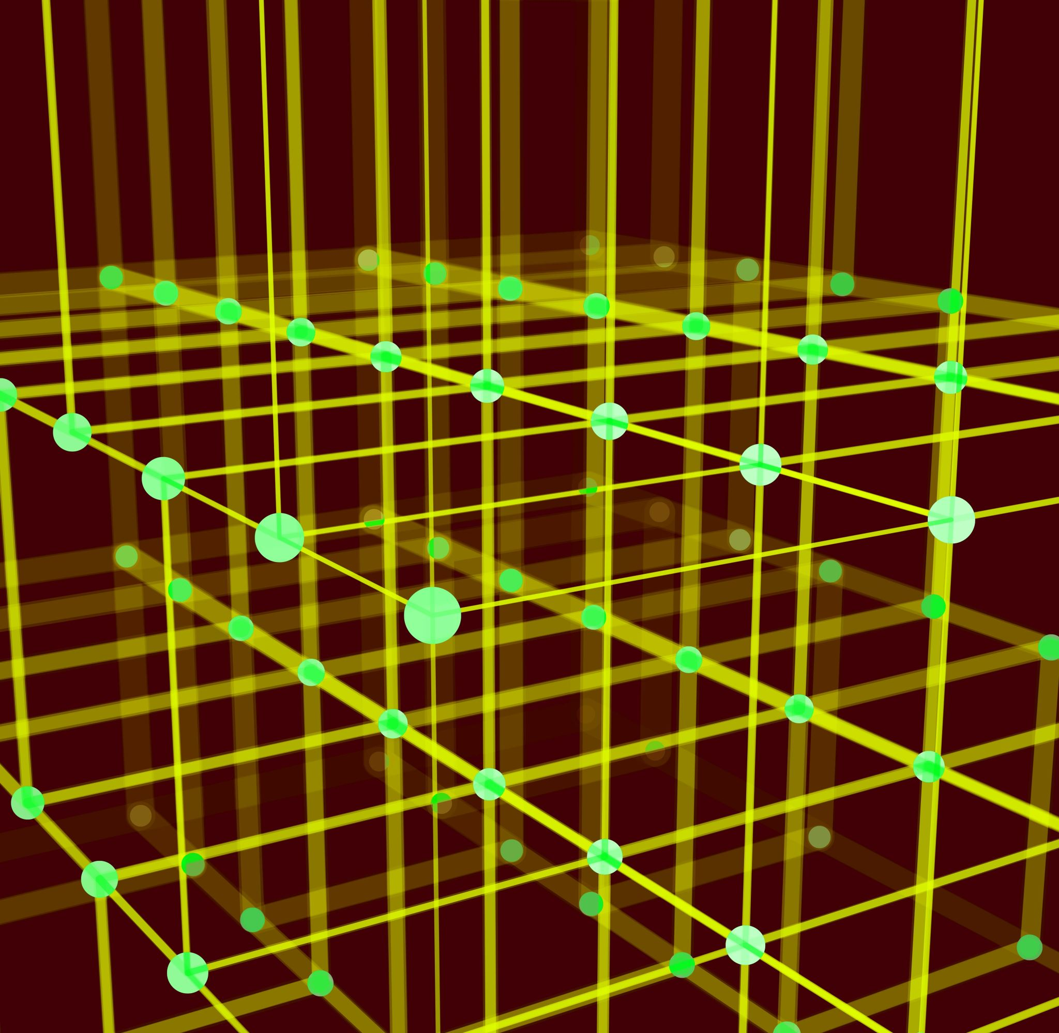



Initial Design
Creating our design requirements

Slide 5

Initial Design
If you do not know how the application should look, it is easy to sit in front of your computer and stare at the screen. When you sit there, staring at the screen, you are wasting time. In industry, we charge $75 to $250 per hour for application development, depending on the complexity of the project and the required skill set. Time really is money. Do you want to waste money (time) by staring at the screen, or do you want to design your application so you can be more efficient?
In this initial phase we develop two key blueprints to our project:
The Wireframe Diagram
The UML Diagram

Slide 6
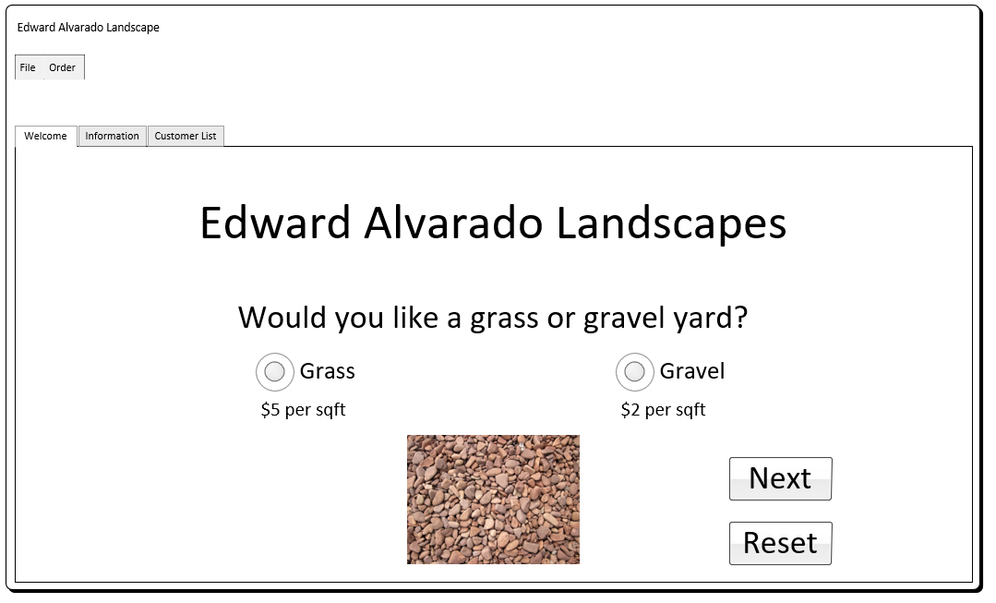
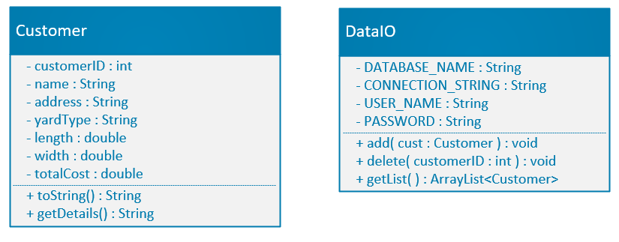
Initial Design
Wireframe Diagram
UML Diagram
The wireframe diagram acts as our visual aid throughout the project.
The UML diagram breaks down the program components into attributes, methods and general functionality.

Slide 7

Developing the GUI
Bringing our design to life

Slide 8
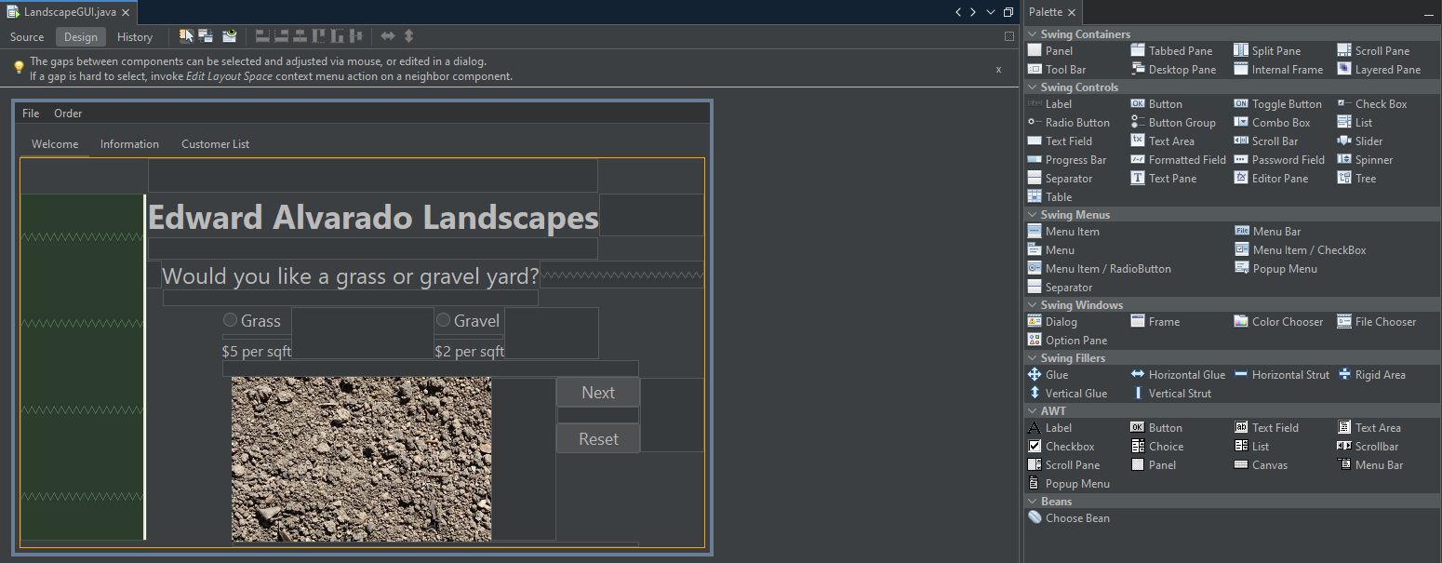
Developing the GUI
In this phase of our project, we focus on taking on design concepts we developed in the wireframe diagram and UML diagram and translating those concepts into our IDE. For this project I used Apache NetBeans IDE 17 and took advantage of the built in GUI design systems in NetBeans to flesh out the look of the program.

Slide 9

Advanced Controls
Bringing function to functionality

Slide 10
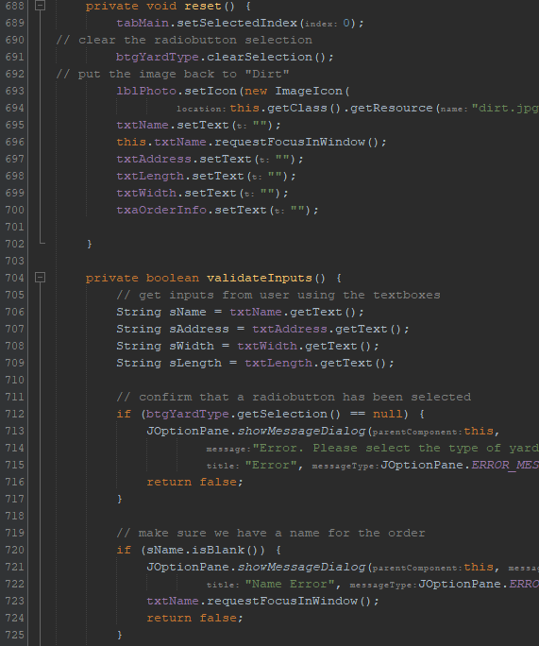
Advanced Controls
Focusing on some of the advanced controls of our GUI we begin to add the functionality, bringing our design to life. Here is where we work on the underlying code of our program to ensure all the buttons and systems work.

Slide 11

Arrays Tabs JLists
Preparing for IO

Slide 12
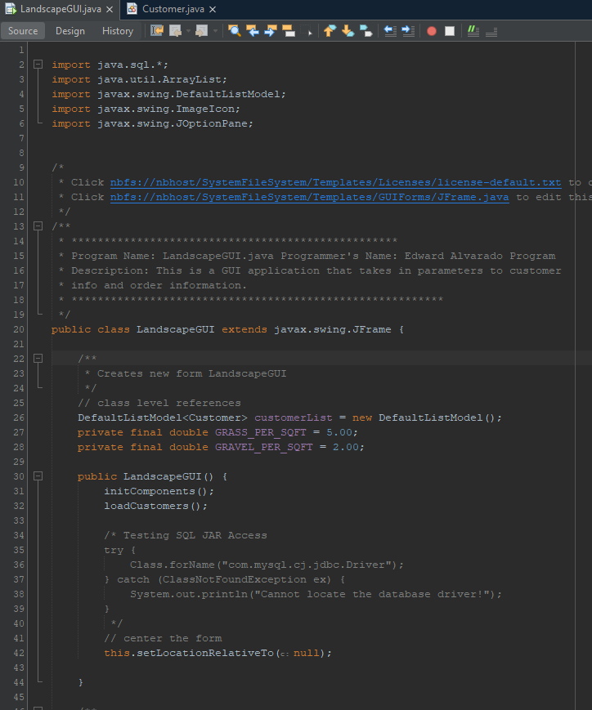
Arrays Tabs JLists
Digging into the design with Tabs and JLists creates a cleaner look and adds functionality to the GUI. Building in the JLists and Arrays allows the next step of development to operate successfully, IO functionality.

Slide 13

IO Functionality
Allows reading and saving to files

Slide 14
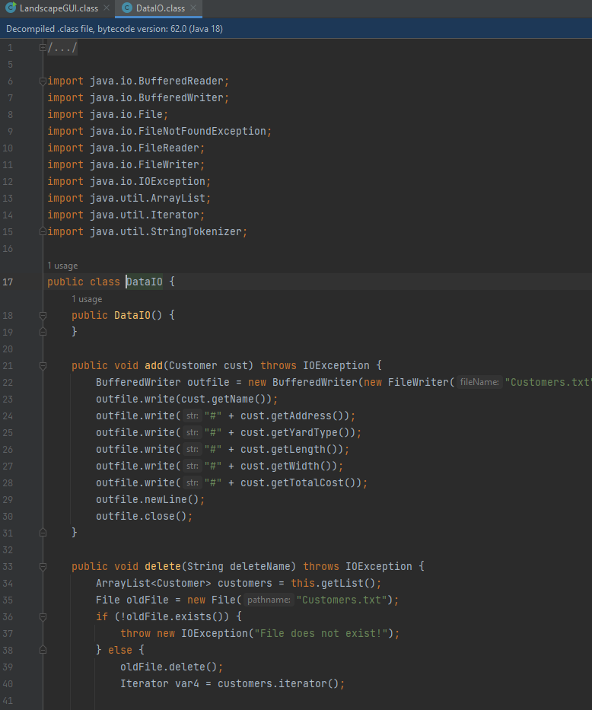
IO Functionality
Adding the ability to save data to your system creating a persistent state that allows the user to create, save and load information as needed.

Slide 15

Database Functionality
Connects our program to databases

Slide 16
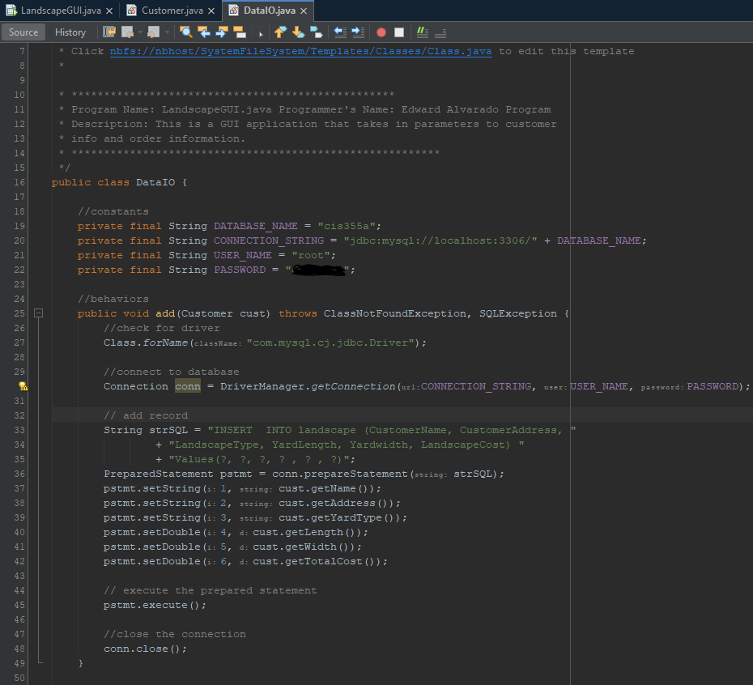
Database Functionality
Allows the user to take the previous IO functionality and use databases like SQL to host the information. Database functionality is fully fleshed out and uses three-tier architecture.

Slide 17
Challenges
Prior to this course the only experience at I had developing a graphical user interface was during my Android development course. Though both classes used JAVA as their primary language this class took the features, techniques and design to a new level. The added database functionality alone takes a standard program and elevates it to real-world business applications. I also used SQL a few times in previous courses so having a refresher on the functionality of databases and how to protect towards threats like injections was eye-opening.

Slide 18
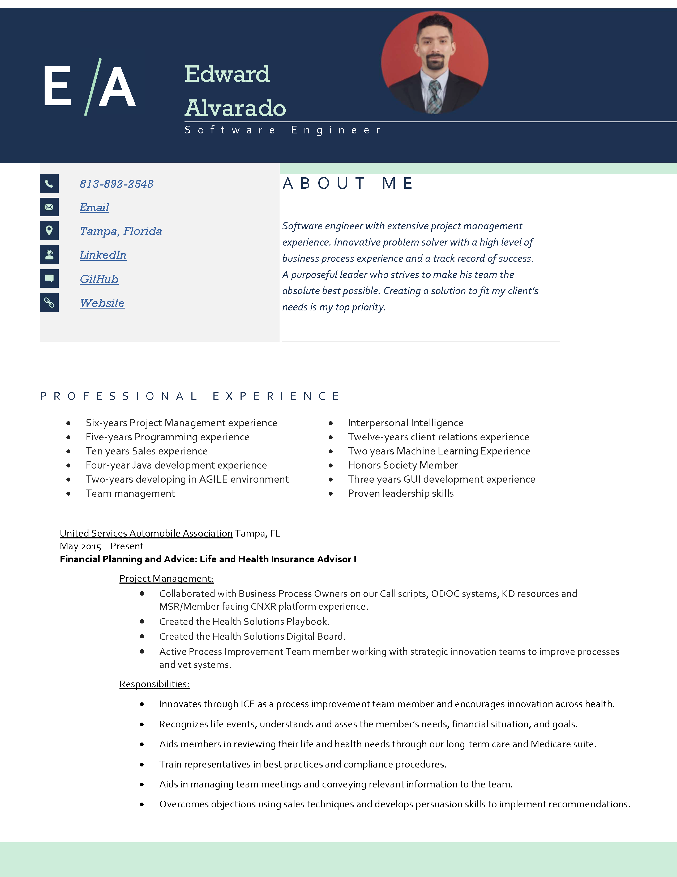
Career Skills Obtained
This course was invaluable to my skillset as I prepare for my future career as a Software Engineer the following skills, were either honed or added to my repertoire:
Microsoft Visio & PowerPoint
Apache NetBeans IDE
JAVA Development
GUI Development
SQL Development
IO Functionality
Database Functionality
Software Development Lifecycle Planning
OOP

Slide 19
Peer-Review
Review one of your fellow student’s projects. The review will have the following information:
Your name:
Student you are reviewing:
Functionality (1-10) with comments:
Design (1-10) with comments:
Communication (1-10) with comments:

Slide 20

Conclusion
With the skills I have gained and improved on throughout this course I am confident in my abilities to succeed in career as a software developer. I will take the best practices I’ve learned and work them into my brand as a reliable, efficient and successful engineer.

Slide 21

Thank you
Edward Alvarado
Website
GitHub

